Slide 1
Principles of Smart Growth: An Introduction to Urban Design, Community Character & Equity in Planning Patrea St. John, RLA, AICP
Notes:
10 county upstate region is growing. By 2040 the population is projected to reach nearly 1,750,000 – an increase of 64% since 1990 and about 300,000 more residents in the next 25 years.
How and where we grow will have real impacts on our quality of life ( transportation, air and water quality and costs)

Slide 2
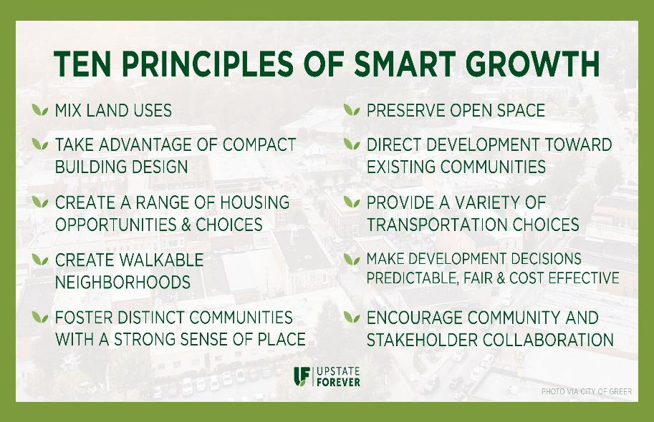
Notes:
What is smart growth?
The Smart Growth Network, which is a partnership of government, business and civic organization that support smart growth developed these 10 principles as ways for communities to develop strategies for development to provide more choices, personal freedom, return on public investment, greater opportunity across the community and a thriving natural environment.
Smart Growth Network includes APA, AIA, EPA, ASLA, Conservation Fund, ITE, Local Government Commission etc…can find full list www.smartgrowth.org

Slide 3
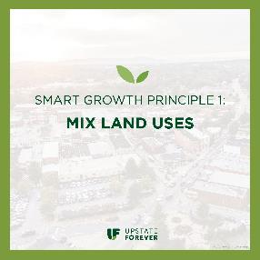
By putting residential, commercial and recreational uses in close proximity to one another, alternatives to driving become viable.
Mixed Use Trip Generation Model/parking by ITE
Provides a more diverse and sizable population and commercial base for supporting public transit; TOD
Enhances vitality and perceived security of an area by increasing the number and activity of people on the street.
Attracts pedestrians and improves community life by making streets, public space and pedestrian oriented retail become places where people meet.
Notes:
Intermodal Transportation Hub – Salt Lake City
Mixed use benefits include health, environmental, & economic benefits
Health: Research shows that over 50% of Americans would walk and bike more than driving if given the opportunity.
Environmental: Reducing sprawl reduces car usage and transportation needs, in addition to preserving open space and undeveloped land.
Economic: Studies how a clear connection between walkable environments and the economic viability of a town.

Slide 4
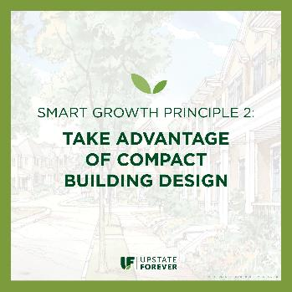
Communities laid out to preserve more open space and individual buildings make more efficient use of land and resources.
Mapping the Dollars and Sense of Land Use Paterns
https://www.upstateforever.org/files/files/2015.05.19_Minicozzi.pdf
Research indicates that well designed, compact New Urbanist communities that include a variety of house sizes and types command a higher market value on a per SF basis than conventional suburban development. This is happening despite current zoning practices that discourage compact design (min. lot sizes ) and negative perceptions if “higher density” development
New Urbanism – based on principles of cities and towns built for last several centuries ( walkable blocks and streets, housing and shopping in close proximity, human scaled ) “ A Pattern Language” Christopher Alexander
Notes:
Mr. Minicozzi, a principal at Urban 3 consulting firm shared eye opening data regarding the tax revenue production of varying development patters and resulting impacts on municipal and county budgets.
A Pattern Language – practical language for building and planning based on natural considerations.
Local example – Patrick Square - Clemson

Slide 5
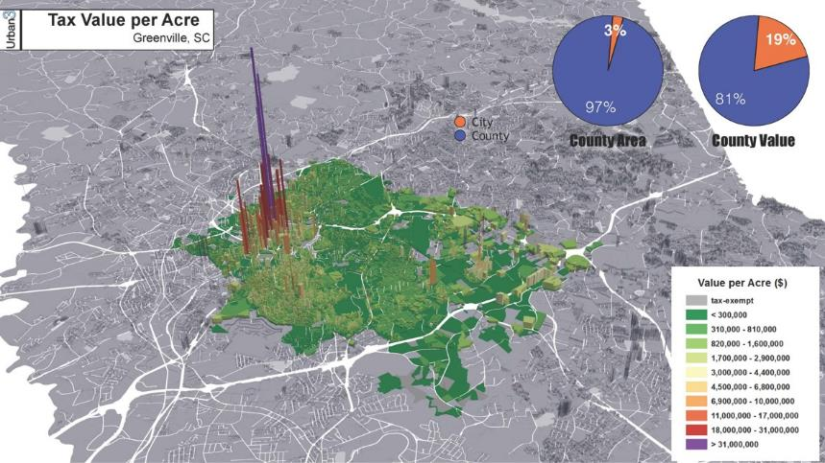
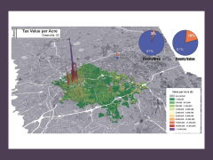
Notes:
This image spatially shows how land development – in urban, suburban and rural areas – is impacting local revenue generation. You can see that while the City of Greenville only account for about 3% of the county’s land area , it is generating 19% of it’s revenue

Slide 6
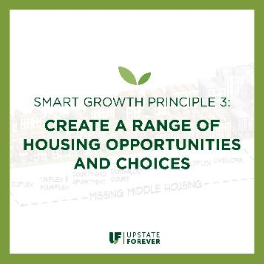
Provide quality housing for people of all income levels .
Increase housing choice by modifying land use patterns on greenfields and by increasing housing supply in existing neighborhoods
Missing Middle Housing – provide diverse housing options such as duplexes, fourplexes, bungalow courts that fit into low rise walkable neighborhoods.
www.missingmiddlehousing.com
Notes:
Housing is critical part of the way communities grow because it consitutues a significant share of new construction and development.

Slide 7
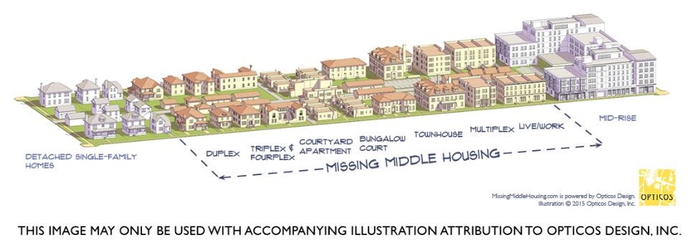
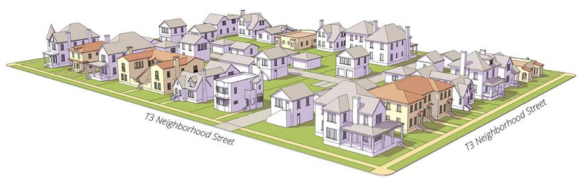
Notes:
Pre 1940’s neighborhoods

Slide 8
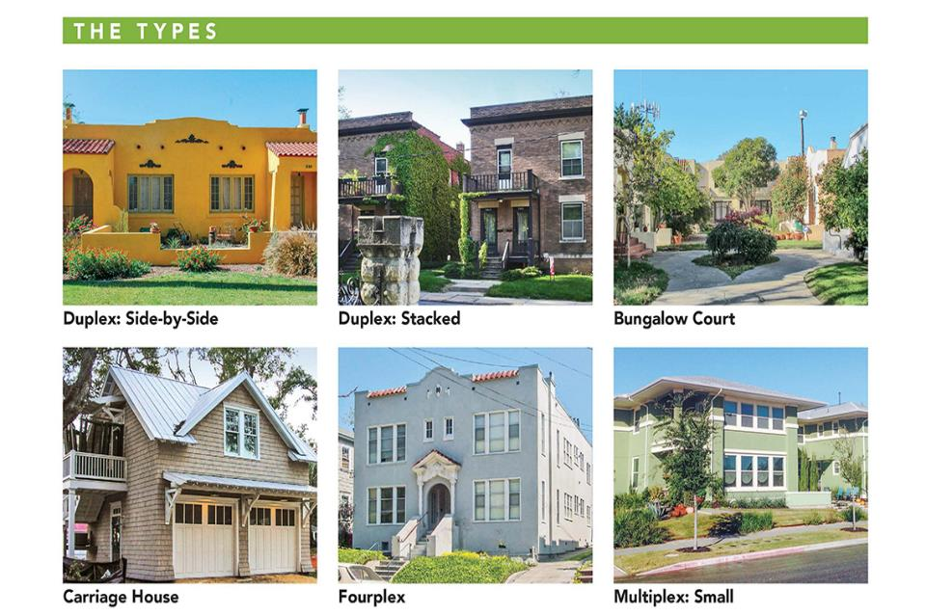
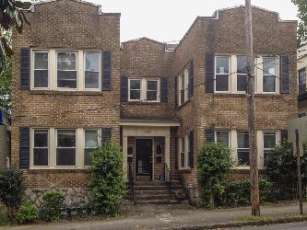
Fourplexes Live Work

Slide 9
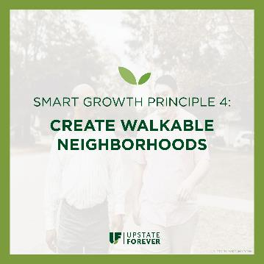
To foster walkability, communities must mix land uses and build compactly, as well as ensure safe and inviting pedestrian corridors.
Connectivity
Complete Streets
Streetscape Components - sidewalks, building transparency, landscape
Notes:
All streets cannot possibly be all things to all users, but all users must be considered and accommodated in the public realm. This means more than providing a separate facility for each user; it is an exercise that acknowledges the limitations and interactions of each user group with the others and balances the priorities of each group within a hierarchy of street types.

Slide 10
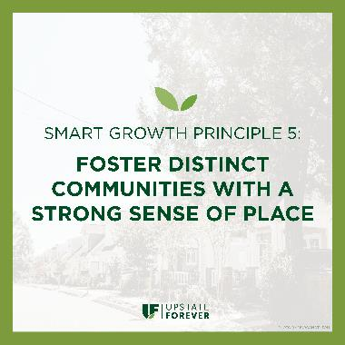
Encourage communities to craft a vision and set standards for development that reflect the community values and cultures of the people who reside there and create physical environments that support a more cohesive community fabric.
Public Realm – the spaces between the buildings
Placemaking – Project for Public Spaces
Design Vocabulary- Design Guidelines vs. Development Standards
Notes:
Placemaking – community based participation process that identifies and capitalizes on a local community’s assets, inspiration and potential and results in creation of quality public spaces. Jane Jacobs & William Whyte

Slide 11
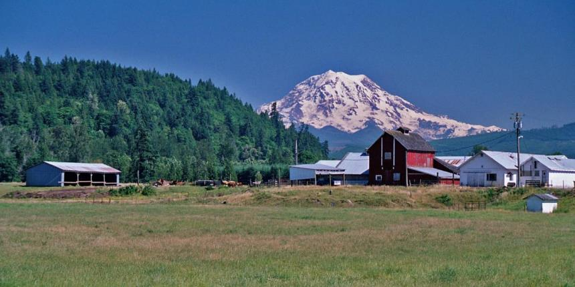
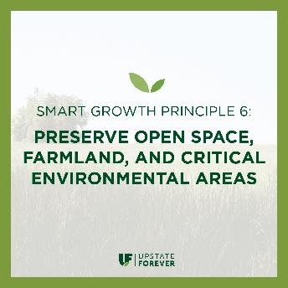
Design by Nature – Ian McHarg
“Our eyes do not divide us from the world, but they unite us to it
Let us abandon the simplicity of separation and give unity its due.
Let us abandon the self mutilation which has been our way and give expression to the potential harmony of man-nature…
Man is that uniquely conscious creature who can perceive and express. He must become the steward of the biosphere. To do this, he must design with nature.”
Resource Conservation zoning – urban limits
Conservation Design for Subdivisions
cluster development – open space networks
Randall G. Arendt – Rural by Design
Scuffletown Rural Preservation Overlay

Slide 12
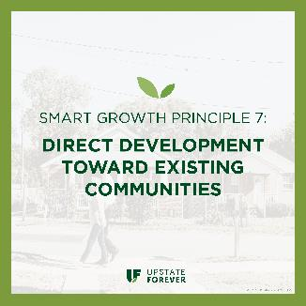
Reinforces many of the other principles ( compact growth, preserve open space etc,)
Greenfield Development vs. Redevelopment Costs
Fiscal Environmental
Social
Greenville County Comprehensive Plan – Plan Greenville Countyhttps://www.greenvillecounty.org/apps/ComprehensivePlanBlog/Blog.aspx
City of Greenville Comprehensive Plan
Shaping our Future – Upstate Forever.
Notes:
Upstate is growing…projections to reach 1,750,000 by 2040, How will we accommodate that growth. Greenville county – 180,000.
Consumption of land if maintained on same trajectory will use nearly 206,000 acres

Slide 13
Notes:
Scenario planning for Greenville county Comprehensive Plan - Scenario 2 was the preferred and led to the development of the Future Land Use Map

Slide 14
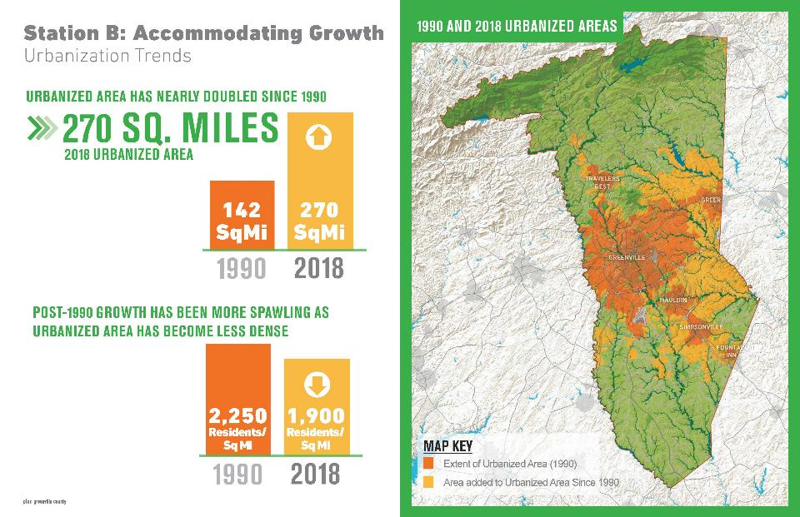
Notes:
Scenario planning for Greenville county Comprehensive Plan - Scenario 2 was the preferred and led to the development of the Future Land Use Map

Slide 15
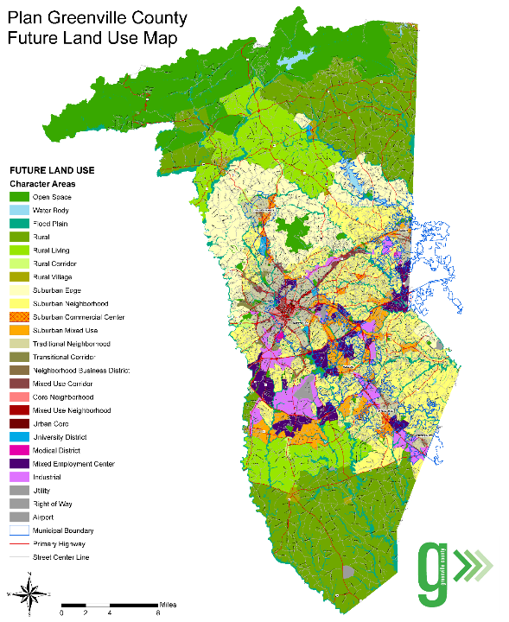

Slide 16
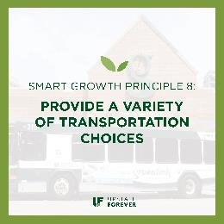
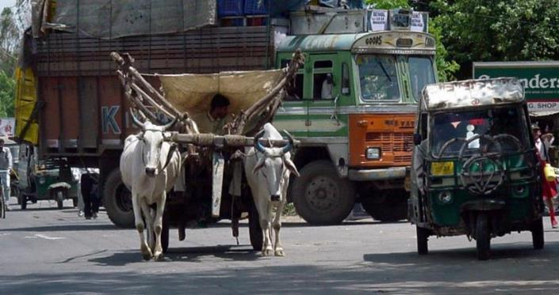
Notes:
Pedestrian, bicycles, transit etc.

Slide 17
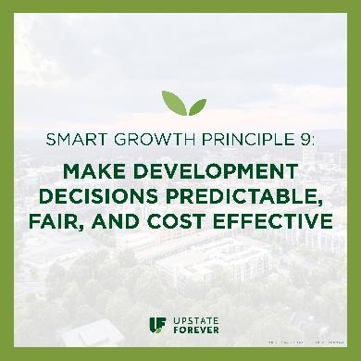
To make smart growth successful a community needs to partner with the private sector
Concurrency - infrastructure, schools and parks
Development Impact Fees

Slide 18
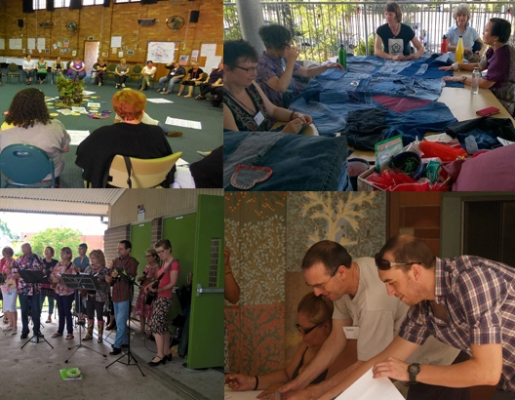
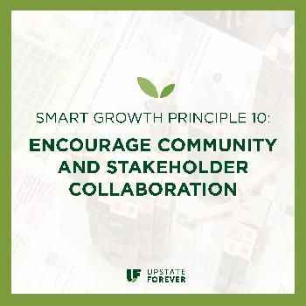
Develop an inclusionary process
Use effective and appropriate communication tools
Social media
Internet surveys
Pop up studios
Charrettes

Slide 19
Notes:
What is smart growth?
The Smart Growth Network, which is a partnership of government, business and civic organization that support smart growth developed these 10 principles as ways for communities to develop strategies for development to provide more choices, personal freedom, return on public investment, greater opportunity across the community and a thriving natural environment.
Smart Growth Network includes APA, AIA, EPA, ASLA, Conservation Fund, ITE, Local Government Commission etc…can find full list www.smartgrowth.org

